Slide 1
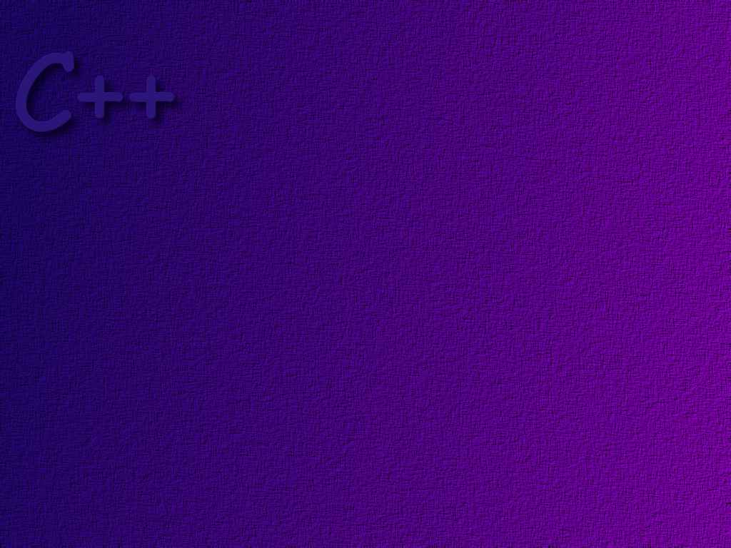
GUI’s Part Two
wxWidgets components

Slide 2
Resources for wxWidgets
Sample code on course website
wxWidgets web site

Slide 3
Hint: Until you feel comfortable with
wxWidgets code, start with some code
that you know works, and add/modify
the code to add new function.

Slide 4
wxApp
#include <wx/app.h>
The wxApp class represents the application itself. Its major function is
to implement the windowing system message or event loop.
Application processing is started by calling the OnInit( ) function.
You should use the macro IMPLEMENT_APP(appClass) in
your application implementation file to tell wxWindows
to create an instance of your application class.

Slide 5
wxFrame
#include <wx/frame.h>
A frame is a window whose size and position can (usually) be
changed by the user. It usually has thick borders and a title bar,
and can optionally contain a menu bar, toolbar and status bar.
A frame can contain any window that is not a frame or dialog.

Slide 6
wxPanel
#include <wx/panel.h>
A panel is a window on which controls are placed. It is usually
placed within a frame. It contains minimal extra functionality
over and above its parent class wxWindow; its main purpose
is to provide a two-dimensional space into which other
components (buttons, lists, etc) can be placed.

Slide 7
Constructor
wxPanel(wxWindow* parent, wxWindowID id = -1,
const wxPoint& pos = wxDefaultPosition,
const wxSize& size = wxDefaultSize,
long style = wxTAB_TRAVERSAL,
const wxString& name = "panel")

Slide 8
wxButton
#include <wx/button.h>
A button is a control that contains a text string,
and is one of the commonest elements of a GUI.
It may be placed on a panel, or indeed almost any
other window. Buttons generate “button clicked” events.
Event Table Entry
EVT_BUTTON(id, function)

Slide 9
Constructor
wxButton(wxWindow* parent, wxWindowID id,
const wxString& label,
const wxPoint& pos,
const wxSize& size = wxDefaultSize,
long style = 0,
const wxValidator& validator,
const wxString& name = "button")

Slide 10
wxStaticText
#include <wx/stattext.h>
A static text control displays one or more lines
of read-only text. Generally they are used for
labels.

Slide 11
Constructor
wxStaticText(wxWindow* parent, wxWindowID id,
const wxString& label,
const wxPoint& pos,
const wxSize& size = wxDefaultSize,
long style = 0,
const wxString& name = "staticText")

Slide 12
wxTextCtrl
#include <wx/textctrl.h>
A text control creates a field of text that may
be edited.
You can use the stream insertion operator
to insert data into a wxTextCtrl.
wxTextCtrl *control = new wxTextCtrl(...);
*control << 123.456 << " some text\n";

Slide 13
Constructor
wxTextCtrl(wxWindow* parent, wxWindowID id,
const wxString& value = "",
const wxPoint& pos = wxDefaultPosition,
const wxSize& size = wxDefaultSize,
long style = 0,
const wxValidator& validator = wxDefaultValidator,
const wxString& name = wxTextCtrlNameStr)

Slide 14
Other useful functions
void AppendText ( const wxString text);
Appends the text to the end of the text currently
displayed in the control.
void Clear( );
Clears all text from the control.
wxString GetLineText ( long lineno ) const;
Returns the text at line lineno.
wxString GetValue( );
Returns the value stored in the control.

Slide 15
wxRadioButton
#include <wx/radiobut.h>
A button that represents one of a mutually exclusive
set of options. Usually represented as a round button’
with a text label alongside. Radio buttons generate
“radiobutton selected” events.
medium
large
small
Event Table Entry
EVT_RADIOBUTTON(id, function)

Slide 16
Constructor
wxRadioButton(wxWindow* parent, wxWindowID id,
const wxString& label,
const wxPoint& pos = wxDefaultPosition,
const wxSize& size = wxDefaultSize,
long style = 0,
const wxValidator& validator = wxDefaultValidator,
const wxString& name = "radioButton")

Slide 17
bool GetValue ( );
If the button is selected, it returns TRUE.

Slide 18
wxCheckBox
#include <wx/checkbox.h>
A checkbox is a labeled field that is either on
(contains a checkmark) of off (no checkmark).
Checkboxes generate “checkbox clicked” event.
✓
sausage
extra cheese
pepperoni
Event Table Entry
EVT_CHECKBOX(id, function)

Slide 19
Constructor
wxCheckBox(wxWindow* parent, wxWindowID id,
const wxString& label,
const wxPoint& pos = wxDefaultPosition,
const wxSize& size = wxDefaultSize,
long style = 0, const wxValidator& val,
const wxString& name = "checkBox")

Slide 20
bool GetValue ( );
If the box is checked , it returns TRUE.
bool IsChecked( );
Performs the same function as GetValue( );

Slide 21

wxChoice
#include <wx/choice.h>
Allows the user to select one of a list of strings.
Only the current selection is visible until the
user pulls down the list of choices. A Choice object
generates “choice selected” events.
large
large
medium
small
Event Table Entry
EVT_CHOICE(id, function)

Slide 22
Constructor
wxChoice(wxWindow *parent, wxWindowID id,
const wxPoint& pos,
const wxSize& size,
int n,
const wxString choices[],
long style = 0,
const wxValidator& validator = wxDefaultValidator,
const wxString& name = "choice")

Slide 23
int GetSelection ( );
Returns the index of the selected string or -1
if none is selected.

Slide 24
Write some code…
Sample code is available in the “Case Studies” tab on the
Course web site.

